Slide 1
Customer churn analysis
By:- Rahul Mutalik

Slide 2
Abstract
A certain ban in North America wants to perform churn analyse as the credit card business of the bank is not performing very well.
Churn analyse will help the bank to evaluate the customers who have stopped purchasing the credit card.

Slide 3
Objective
Analyse the customer data of a North American bank and build an interactive dashboard using tableau.
Building a dashboard will involve analysing the data presenting the results using Graphs.

Slide 4
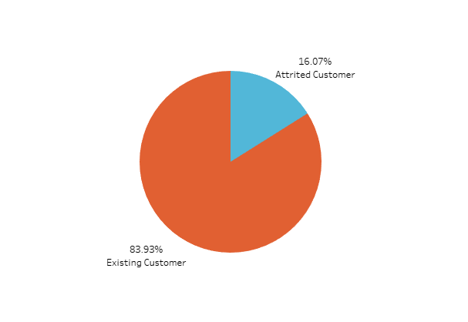
Attired & Existing customers
Attired Customers | 16%
Existing Customers | 84%

Slide 5
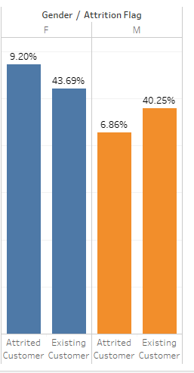
Gender wise Attired and Existing customers.
Female Attired customers are more than male.

Slide 6
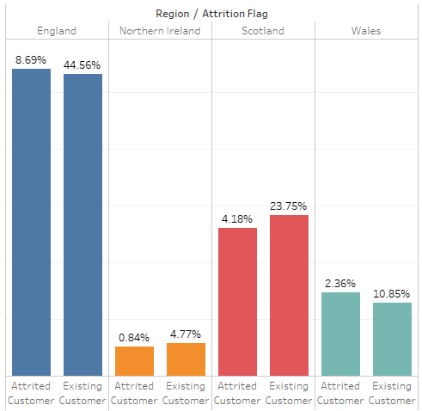
Region wise Attired and Existing customers.
Most of our customers are from England region

Slide 7
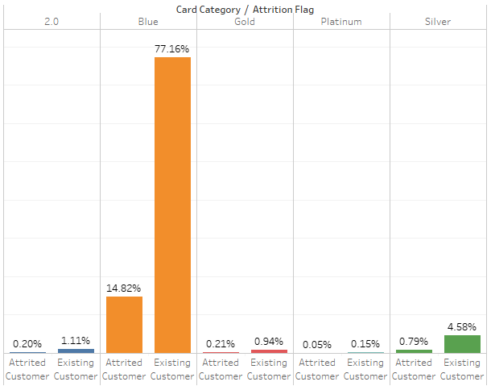
Card Category attired and existing customers
Customers who Posses blue type of card are around 92% of total customers and 77.16% are existing customers

Slide 8
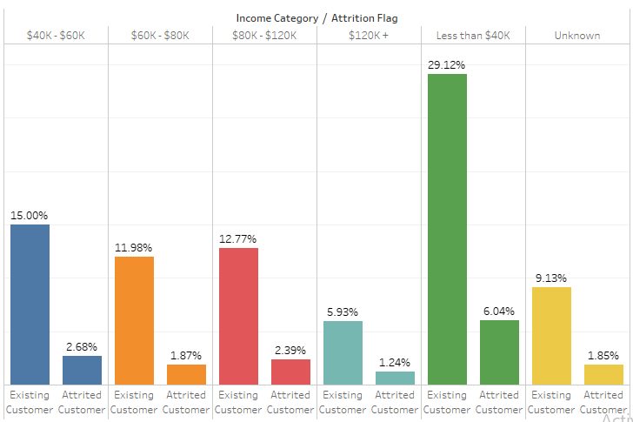
Income Category wise attired customers and existing customers
About 29.12% Existing customers have salary less than $40K

Slide 9
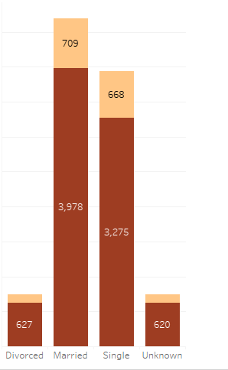
Marital status wise attrition flag
 | Attired | Existing
Married | 709 | 3,978
Single | 668 | 3,275
divorced | 121 | 627
Most of Existing customers are married that make around39.28% of total customers.

Slide 10
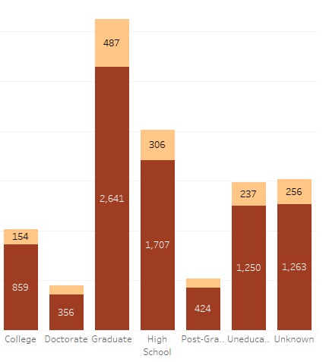
Education wise Attrition Flag
 | Attired | Existing
High school | 306 | 1707
college | 154 | 859
graduate | 487 | 2641
Post graduate | 92 | 424
Doctorate | 95 | 356
Uneducated | 237 | 1250

Slide 11
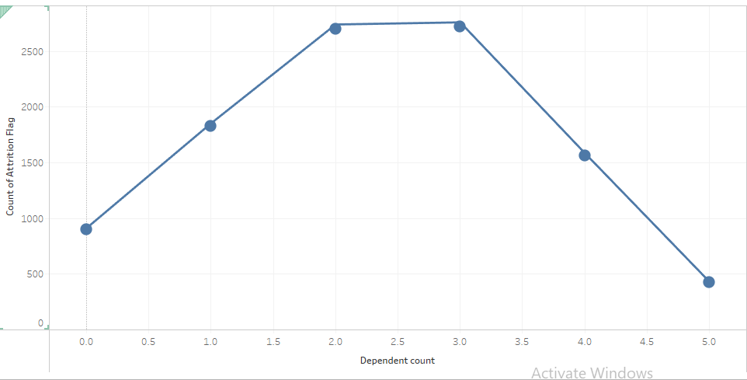
Dependent wise total Attrition flag
Customers who have 2 to 3 dependent have likely to approach bank.

Slide 12
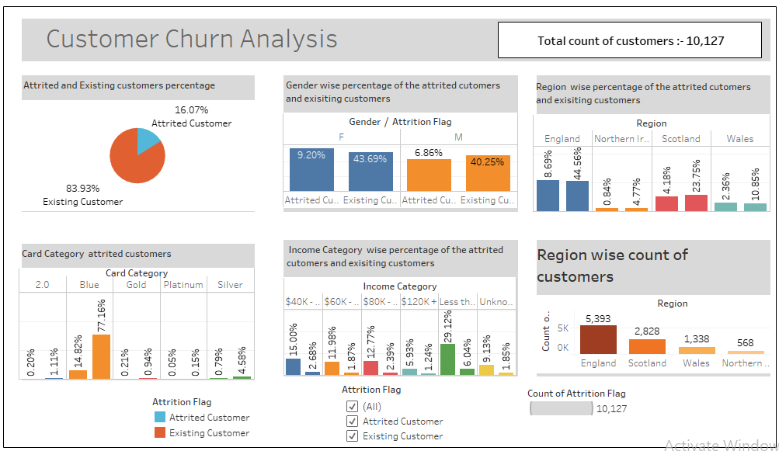

Slide 13
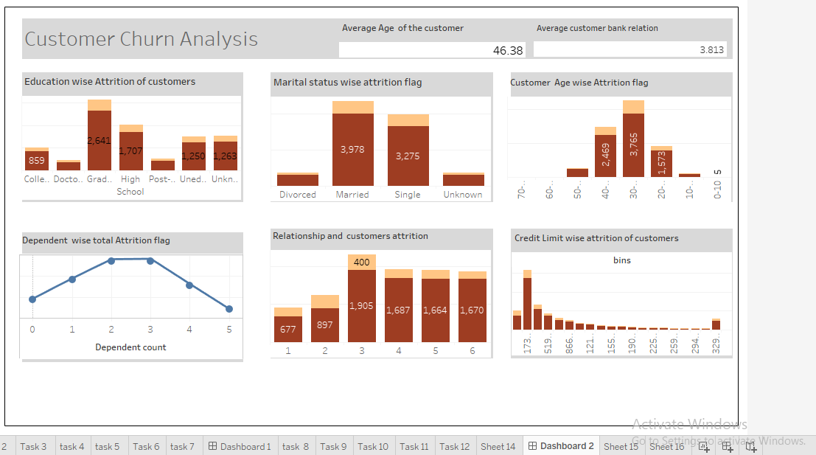

Slide 14
Insights
Female Attired customers are more than male.
Around 84% customers are Existing Customers.
Most of our customers are from England region.
Customers who have blue type of card are around 92% of total customers and 77.16% are existing customers
Customers who have 2 to 3 dependent have likely to approach bank.
Exciting customers have high school as their primarily education.
About 29.12% Existing customers have salary less than $40K
Most of Existing customers are married that make around39.28% of total customers.

Slide 15
Recommendations
Females Who belong to England region are mostly likely to churn.
Have a back round check of the salary of the females who’s salary less than $40k as there are most distinctly possible to churn.
Bank should focus on graduate and high schools background customers.
Bank Should try to provide best services for those customers who are their with the bank for more than 2 years.
Bank should focus on customers who age between 30 to 50.

Slide 16
Thank you

